Slide 1
What is Kubernetes?
Kubernetes is a portable, extensible, open-source platform for managing containerized workloads and services, that facilitates both declarative configuration and automation. It has a large, rapidly growing ecosystem. Kubernetes services, support, and tools are widely available.
The name Kubernetes originates from Greek, meaning helmsman or pilot. K8s as an abbreviation results from counting the eight letters between the "K" and the "s". Google open-sourced the Kubernetes project in 2014. Kubernetes combines over 15 years of Google's experience running production workloads at scale with best-of-breed ideas and practices from the community

Slide 2
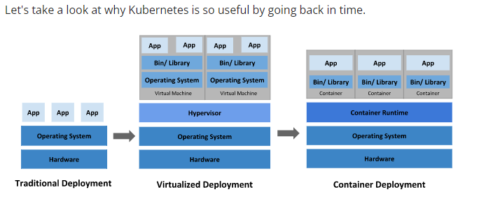
Why Kubernetes is so useful

Slide 3
Why you need Kubernetes and what it can do
Containers are a good way to bundle and run your applications. In a production environment, you need to manage the containers that run the applications and ensure that there is no downtime. For example, if a container goes down, another container needs to start. Wouldn't it be easier if this behavior was handled by a system?
That's how Kubernetes comes to the rescue! Kubernetes provides you with a framework to run distributed systems resiliently. It takes care of scaling and failover for your application, provides deployment patterns, and more. For example, Kubernetes can easily manage a canary deployment for your system.

Slide 4
Kubernetes provides you with:
Service discovery and load balancing Kubernetes can expose a container using the DNS name or using their own IP address. If traffic to a container is high, Kubernetes is able to load balance and distribute the network traffic so that the deployment is stable.
Storage orchestration Kubernetes allows you to automatically mount a storage system of your choice, such as local storages, public cloud providers, and more.
Automated rollouts and rollbacks You can describe the desired state for your deployed containers using Kubernetes, and it can change the actual state to the desired state at a controlled rate. For example, you can automate Kubernetes to create new containers for your deployment, remove existing containers and adopt all their resources to the new container.
Automatic bin packing You provide Kubernetes with a cluster of nodes that it can use to run containerized tasks. You tell Kubernetes how much CPU and memory (RAM) each container needs. Kubernetes can fit containers onto your nodes to make the best use of your resources.
Self-healing Kubernetes restarts containers that fail, replaces containers, kills containers that don't respond to your user-defined health check, and doesn't advertise them to clients until they are ready to serve.
Secret and configuration management Kubernetes lets you store and manage sensitive information, such as passwords, OAuth tokens, and SSH keys. You can deploy and update secrets and application configuration without rebuilding your container images, and without exposing secrets in your stack configuration.

Slide 5
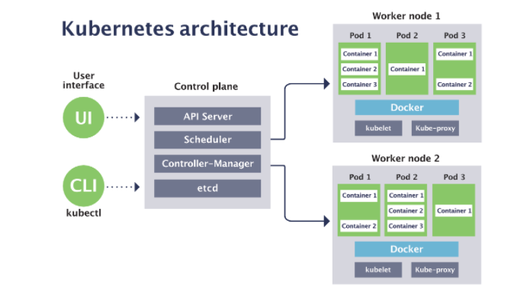

Slide 6
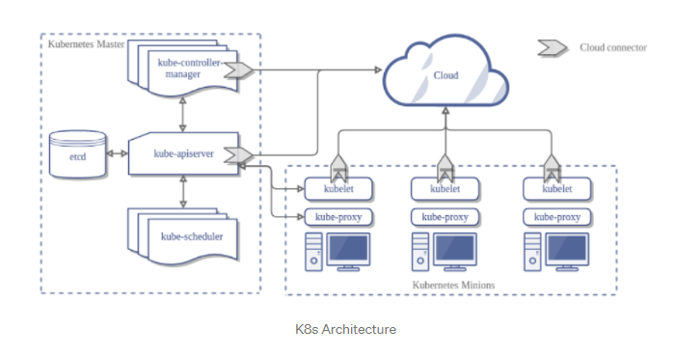

Slide 7
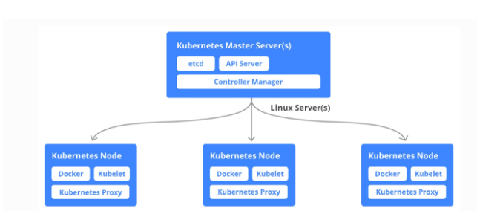
Master Node Components
API Server 2. Controller Manager 3. ETCD 4. Scheduler

Slide 8
kube-apiserver
The API server is a component of the Kubernetes control plane that exposes the Kubernetes API. The API server is the front end for the Kubernetes control plane.
The main implementation of a Kubernetes API server is kube-apiserver. kube-apiserver is designed to scale horizontally—that is, it scales by deploying more instances. You can run several instances of kube-apiserver and balance traffic between those instance
etcd
Consistent and highly-available key value store used as Kubernetes' backing store for all cluster data.

Slide 9
kube-scheduler
Control plane component that watches for newly created Pods with no assigned node, and selects a node for them to run on.
Factors taken into account for scheduling decisions include: individual and collective resource requirements, hardware/software/policy constraints, affinity and anti-affinity specifications, data locality, inter-workload interference, and deadlines.
kube-controller-manager
Control plane component that runs controller processes.
Logically, each controller is a separate process, but to reduce complexity, they are all compiled into a single binary and run in a single process.
Some types of these controllers are:
Node controller: Responsible for noticing and responding when nodes go down.
Job controller: Watches for Job objects that represent one-off tasks, then creates Pods to run those tasks to completion.
Endpoints controller: Populates the Endpoints object (that is, joins Services & Pods).
Service Account & Token controllers: Create default accounts and API access tokens for new namespaces.

Slide 10
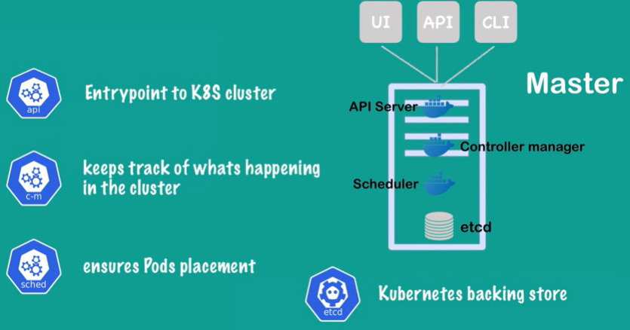
Master Node

Slide 11
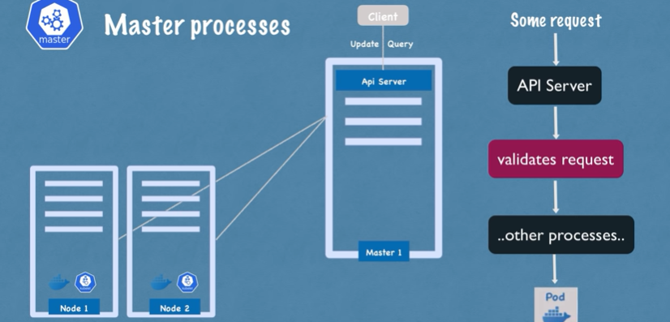
API Server

Slide 12
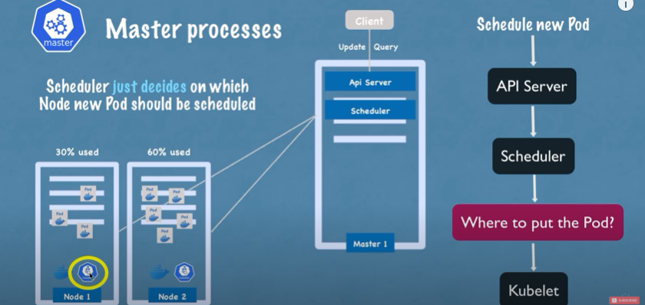
Scheduler

Slide 13
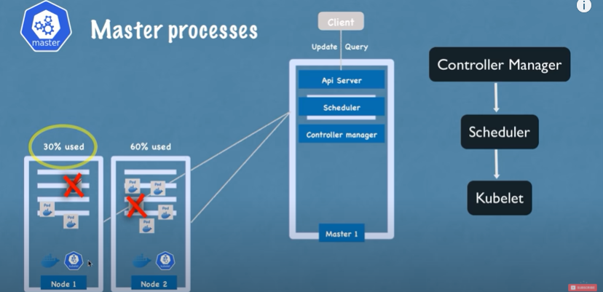
Controller Manager

Slide 14
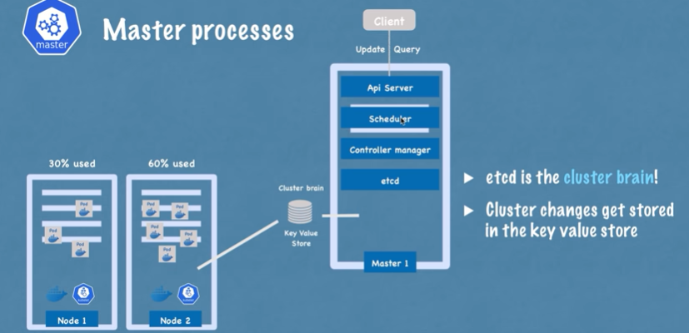
etcd

Slide 15
Node Components
Node components run on every node, maintaining running pods and providing the Kubernetes runtime environment.
kubelet
An agent that runs on each node in the cluster. It makes sure that containers are running in a Pod.
The kubelet takes a set of PodSpecs that are provided through various mechanisms and ensures that the containers described in those PodSpecs are running and healthy. The kubelet doesn't manage containers which were not created by Kubernetes.
kube-proxy
kube-proxy is a network proxy that runs on each node in your cluster, implementing part of the Kubernetes Service concept.
kube-proxy maintains network rules on nodes. These network rules allow network communication to your Pods from network sessions inside or outside of your cluster.
kube-proxy uses the operating system packet filtering layer if there is one and it's available. Otherwise, kube-proxy forwards the traffic itself.
Container runtime
The container runtime is the software that is responsible for running containers.
Kubernetes supports several container runtimes: Docker, containerd, CRI-O, and any implementation of the Kubernetes CRI (Container Runtime Interface).

Slide 16
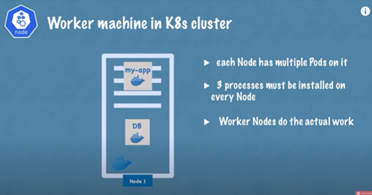
Worker Node

Slide 17
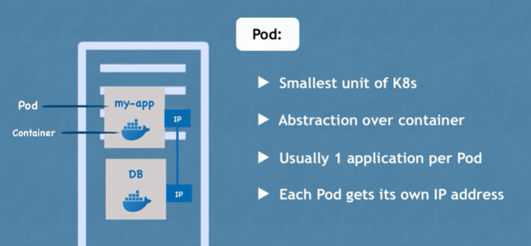

Slide 18
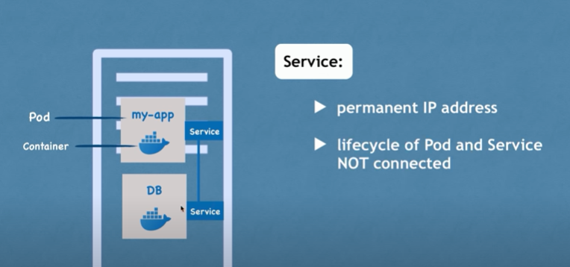

Slide 19
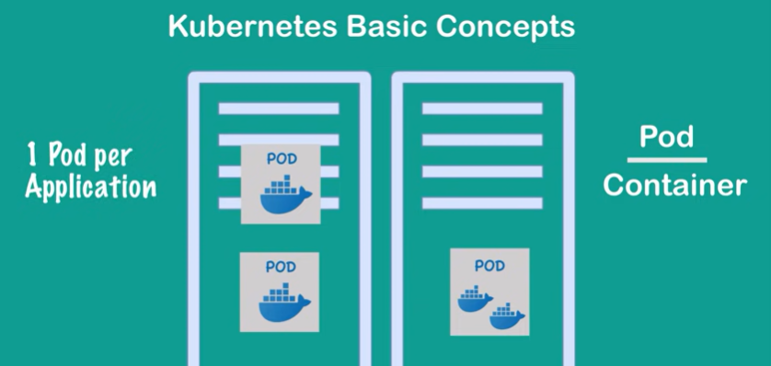

Slide 20
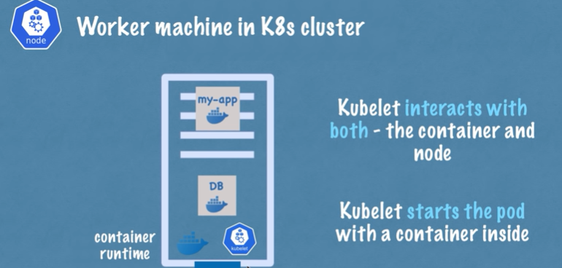
Kubelet

Slide 21
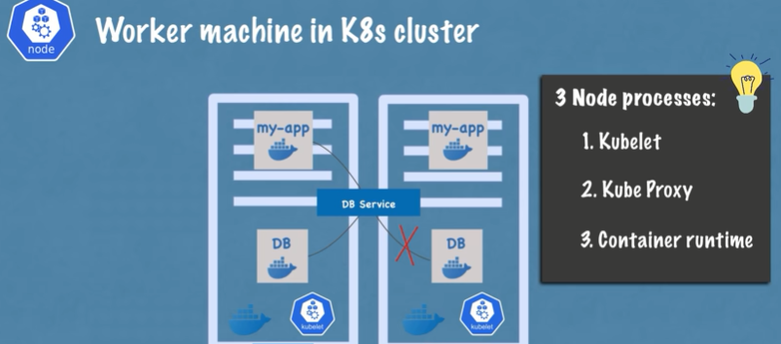

Slide 22
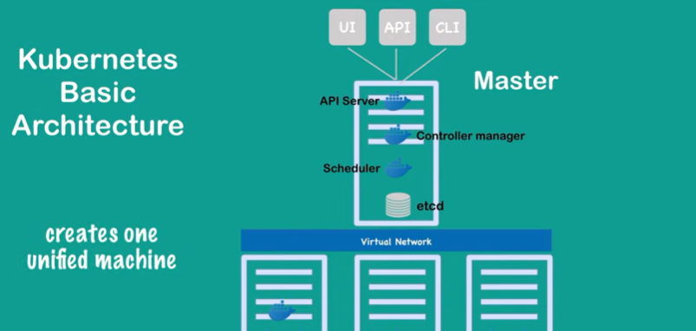
Virtual Network

Slide 23
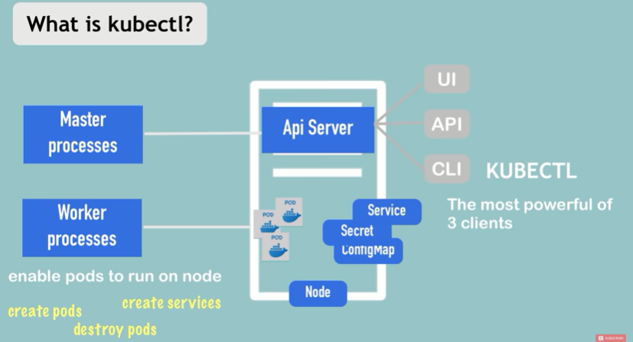
Kubectl

Slide 24
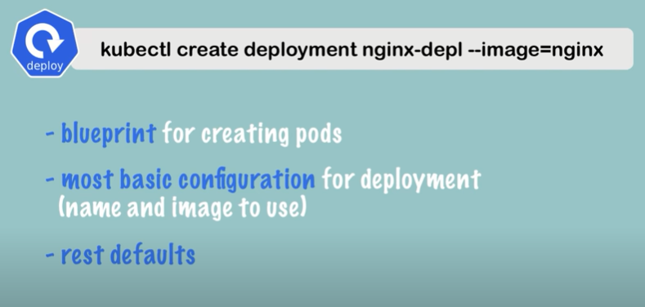
Deployment

Slide 25
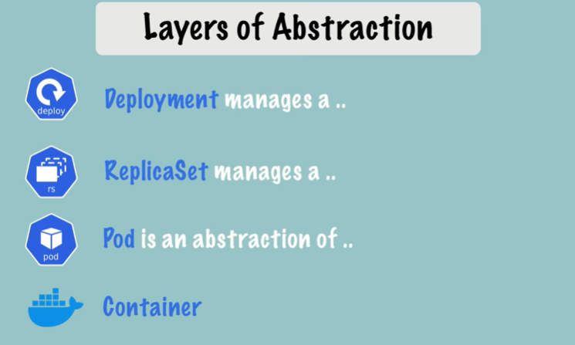

Slide 26
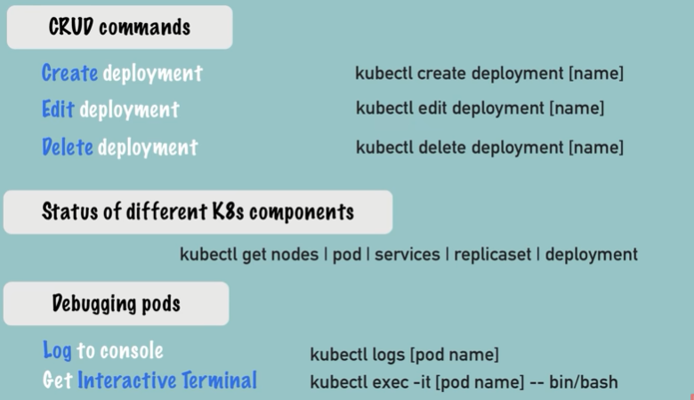

Slide 27
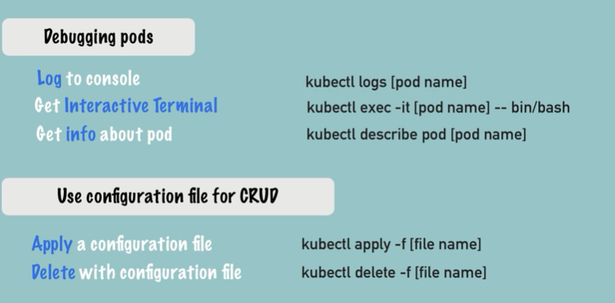

Slide 28
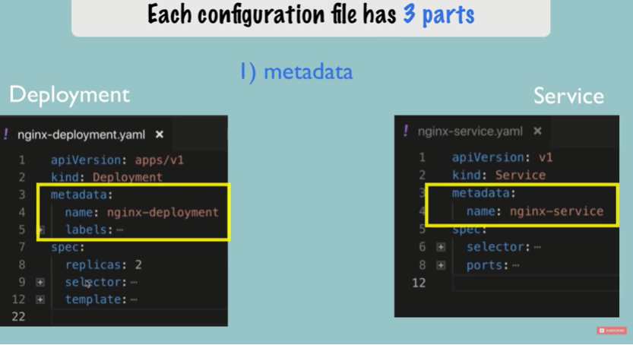

Slide 29
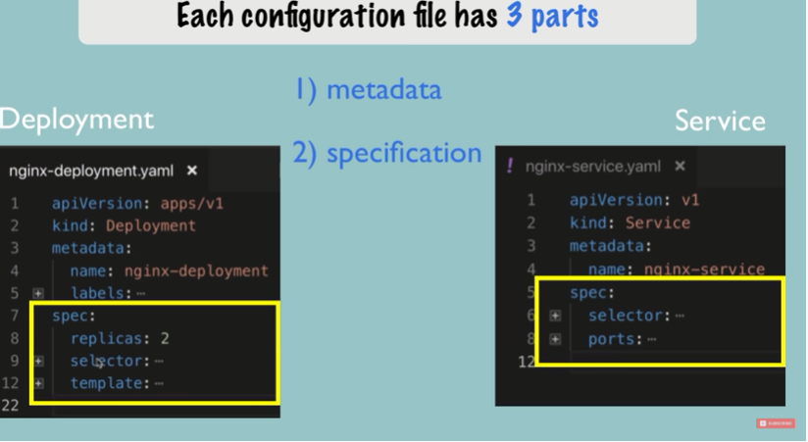

Slide 30
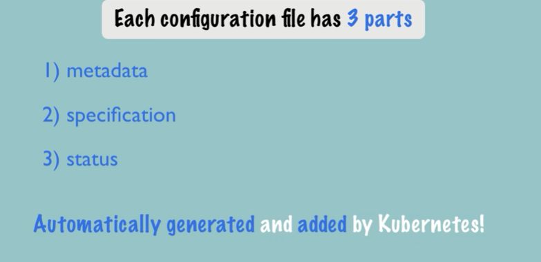

Slide 31
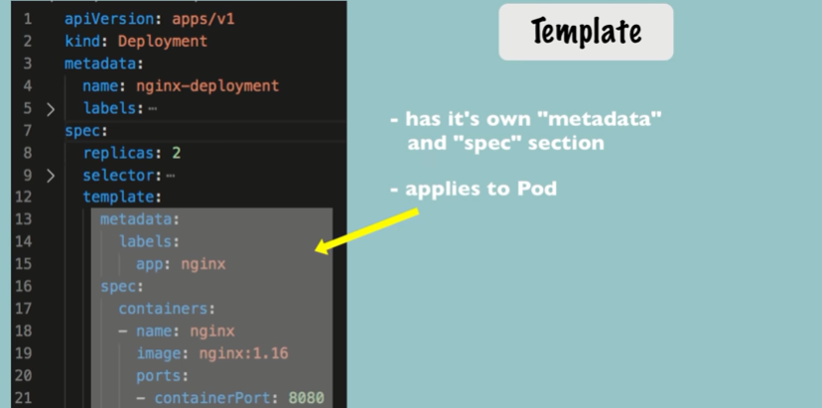

Slide 32
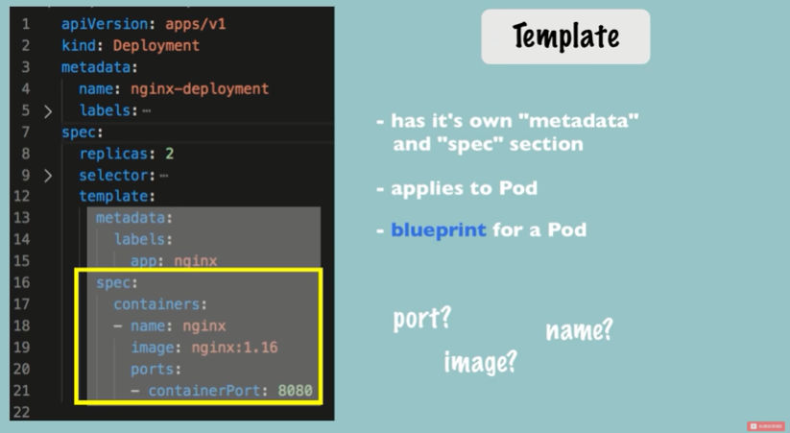

Slide 33
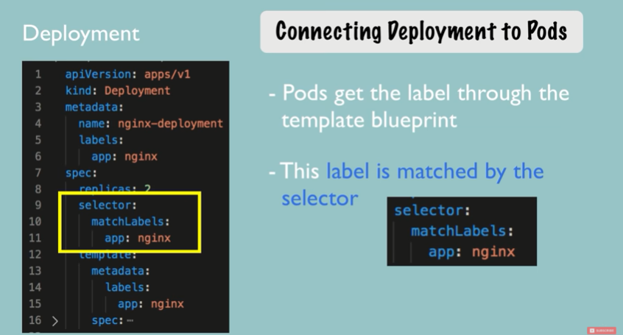

Slide 34
